Slide 1
Asynchronous JavaScript and APIs
Mack 2022

Slide 2
Introduction
JSON (JavaScript Object Notation) is a standardized format for structuring data. It is heavily based on the syntax for JavaScript objects. You will often encounter JSON formatted data when working with external servers or APIs - it is essentially the universal format for transmitting data on the web.
Fortunately, there isn’t much to learn here. We’re only including a lesson on it because some formatting rules can cause confusion if you aren’t aware of them. Spend 10-15 minutes going through the following resources and you’ll be good to go.

Slide 3
Tutorial
This MDN tutorial is probably all you need…

Slide 4
Read
Read about the 2 JavaScript methods that you’ll most often be using when dealing with JSON - JSON.parse() and JSON.stringify().

Slide 5
Errors
Mis-formatted JSON is a common cause of errors. This webpage lets you paste in JSON code and will search it for formatting errors.

Slide 6
ASYNCHRONOUS CODE

Slide 7
Introduction
Since JavaScript is the language of the web, there are some functions that by necessity are going to take a decent amount of time to complete, such as fetching data from a server to display on your site. For this reason, JavaScript includes support for asynchronous functions, or to put it another way, functions that can happen in the background while the rest of your code executes.

Slide 8
Learning Outcomes
Explain what a callback is
Explain what a promise is
Explain the circumstances under which promises are better than callbacks
Explain what the .then() function does

Slide 9
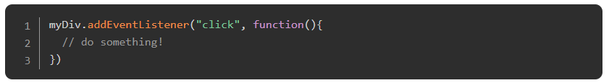
Callbacks
In the recent past, the way that these were most commonly handled were with callbacks, and even now they are still used quite a lot in certain circumstances.
A callback function is a function passed into another function as an argument, which is then invoked inside the outer function to complete some kind of routine or action. MDN
Callbacks are simply functions that get passed into other functions. For example:

Slide 10
Callbacks
Here, the function addEventListener() takes a callback (the “do something” function) and then calls it when myDiv gets clicked.
You will likely recognize this pattern as something that happens all the time in JavaScript code. Unfortunately, though they are useful in situations like the above example, using callbacks can get out of hand, especially when you need to chain several of them together in a specific order. The rest of this lesson discusses patterns and functions that will help keep you out of Callback hell.
Take a moment to skim through this article before moving on. Or, if you prefer a video watch this.

Slide 11
Promises
There are multiple ways that you can handle asynchronous code in JavaScript, and they all have their use cases. Promises are one such mechanism, and they’re one you will see somewhat often when using other libraries or frameworks. Knowing what they are and how to use them is quite useful.
Essentially, a promise is an object that might produce a value at some point in the future. Here’s an example.

Slide 12
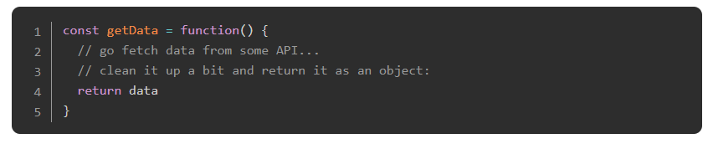
Promises
Lets say getData() is a function that fetches some data from a server and returns it as an object that we can use in our code:

Slide 13

Promises
The issue with this example is that it takes some time to fetch the data, but unless we tell our code that, it assumes that everything in the function happens essentially instantly. So, if we try to do this:

Slide 14
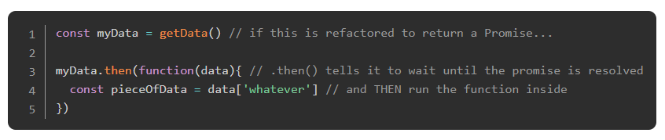
Promises
We’re going to run into trouble because when we try to extract pieceOfData out of the returned data, the function getData() will most likely still be fetching, so myData will not be the expected data, but will be undefined. Sad.
We need some way to solve this problem, and tell our code to wait until the data is done fetching to continue. Promises solve this issue. We’ll leave learning the specific syntax for the articles you’re about to read, but essentially Promises allow you to do this:
Notes:
Of course, there are many more occasions where one would want to use Promises beyond fetching data, so learning these things now will be very useful to you.

Slide 15
Read
Read this article. It’s a good starting place and it’s short and to the point.

Slide 16
Watch
Watch this video. It’s a good place to get a feel for how one might actually use promises in the wild. Feel free to watch the other videos in the series, but they aren’t strictly needed at this point. The video also mentions the ES5/ES6 issue, don’t worry about that at this point either. All major browsers support Promises and we will teach you how to support older browsers in a later lesson.

Slide 17
Watch another thing
Watch this video to understand how asynchronous code works in JavaScript.

Slide 18
Read Chapter 2: Callbacks and Chapter 3: Promises from You Don't Know JS. In Chapter 2, the author explains the problems with callbacks and why callback hell will be your worst enemy (hint: it’s the inversion of control and non-linear nature of callbacks). In Chapter 3, you go deep into the how and why of promises. This chapter is not the easiest read, but you’ll be a promise professional if you take the time to properly digest it. It’s worth the effort.

Slide 19
Check Understanding

Slide 20
What is a callback?
Notes:
🍐 This is a Pear Deck Text Slide
🍐 To edit the type of question, go back to the "Ask Students a Question" in the Pear Deck sidebar.

Slide 21
What is a promise?
Notes:
🍐 This is a Pear Deck Text Slide
🍐 To edit the type of question, go back to the "Ask Students a Question" in the Pear Deck sidebar.

Slide 22
When should you use promises over callbacks?
Notes:
🍐 This is a Pear Deck Text Slide
🍐 To edit the type of question, go back to the "Ask Students a Question" in the Pear Deck sidebar.

Slide 23
Resources
This is another useful article about Callback functions in JavaScript.
The MDN Documentation for Promises. It might not be the best resource for learning all about them, but once you’ve read a more friendly article or tutorial, this will probably be the place you return to for a refresher.
This video and this one too are both nice introductions to Promises if you need more repetition.
This tutorial is another good introduction.

Slide 24
WORKING WITH APIS

Slide 25
Introduction
One of the most powerful things a web developer can do is fetching data from a server and displaying it creatively on their site. In many cases, the server solely exists for that specific site. The server could contain blog posts, user data, high scores for a game or anything else. In other cases, the server is an open service that serves data to anyone that wants to use it (i.e. weather data or stock prices). In either case, the methods of accessing and then using that data are essentially the same.

Slide 26
Learning Outcomes
Explain what an API is
Explain broadly how access to an API works
Explain how to fetch and extract data from an API
Explain why your API request might be blocked by the browser, and how to fix this

Slide 27

APIs
Servers that are created for serving data for external use (in websites or apps) are often referred to as APIs or ‘Application Programming Interfaces’.
There are multiple ways of requesting data from an API, but all of them basically do the same thing. For the most part, APIs are accessed through URLs, and the specifics of how to query these URLs change based on the specific service you are using. For example, the OpenWeatherMap API has several types of data that you can request. To get the current weather in a specific location, you can pass in the name of a city (optionally, you can also add a state code or a country code) as a URL query string parameter, like so:

Slide 28
APIs
The specifics for using any API are usually documented on the service’s website. Check here for the OpenWeatherMap API documentation. If you haven’t already, go ahead and paste the weather URL above, with the city of your choice, into your browser…(we’ll wait).
You’ll probably get an error like this:

Slide 29
APIs
This brings us to another point about APIs. In most cases, you will have to create an account and request an “API key” from the API service before attempting to fetch data from their endpoints. Once obtained, an API key will usually have to be included with every data request, such as another URL query string parameter:
As you can imagine, an API key is random and unique to you. As such, services like OpenWeatherMap can correlate your API key to your requests of their data, including how much and how often you are requesting it.

Slide 30
APIs
On one hand, issuing API keys allows an API service to better track abuse of their systems and data. On the other hand, it can also be a way for those services to mitigate and recuperate operating costs. OpenWeatherMap, for example, provides not only a free tier but a variety of paid tiers that can cost upwards of 2000 USD/month! After all, running servers costs money, and APIs are no exception. While a single request to an API might cost a fraction of a penny, imagine using that API to create an amazing weather app that gets used all over the world….you could easily have thousands of people accessing that data every minute! The cost to handle that traffic could quickly balloon up to significant sums for the API service.

Slide 31
APIs
As such, you’ll find that most API services, if not all, provide paid tiers that come with the ability to make more frequent requests, or provide access to more information unavailable in lower tiers. For example, OpenWeatherMap’s free plan only allows your app to make 60 requests per minute, for a monthly total of 1 million requests, while the “Enterprise” tier allows up to 200,000 requests per minute! The free tier also comes with basic forecasting data, but it does not include data for a 30-day forecast (details here if you’re interested). So, if your app becomes successful and needs additional features, you’ll probably need to pay for a better account.

Slide 32
APIs
Because your API key is your key to these services and data, securing them is an important habit, especially if you are using a paid tier. There are plenty of bots that crawl GitHub repositories solely for hardcoded/unsecured API keys, allowing bad agents to then access and utilize the services and data you’ve paid for. In fact, the more eagle-eyed readers may have noticed a problem with the demonstration above: The API key is right there in the URL request. It would not take much for an internet traffic sniffer to pick up on the API key, least of all someone looking over your shoulder!

Slide 33

APIs
At this point in the curriculum, though, this point is largely moot. After all, we’re leveraging free access to APIs, and the majority of our apps are only going to be used by us and the people that view our portfolios. Just make a note of the severe limitations of using API keys as demonstrated above for now. The basics of securing and obfuscating API keys from GitHub and from your requests will be covered later in the curriculum.
Back to OpenWeatherMap. Go ahead and create an account to obtain an API key from their free tier. Once the key has been activated, which can take up to 2 hours, try making a new request with the city of your choice AND the API key passed in as query string parameters, like the example above. You’ll hopefully see a proper response, something like:

Slide 34
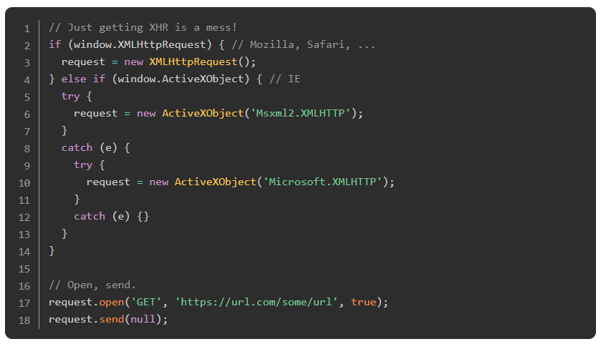
Fetching Data
So how do we actually get the data from an API into our code?
A couple of years ago the main way to access API data in your code was using an XMLHttpRequest. This function still works in all browsers, but unfortunately, it is not particularly nice to use. The syntax looks something like this:

Slide 35
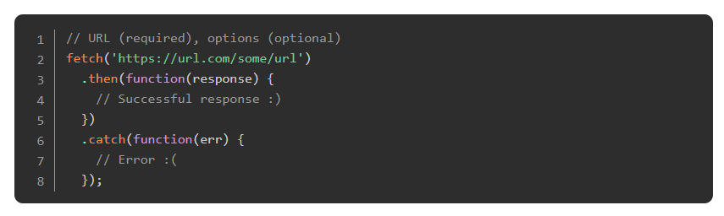
Fetching Data
Ouch. That was painful.
Developers, feeling the pain of having to write that stuff out, began writing 3rd party libraries to take care of this and make it much easier to use. Some of the more popular libraries are axios and superagent, both of which have their strengths and weaknesses.
More recently, however, web browsers have begun to implement a new native function for making HTTP requests, and that’s the one we’re going to use and stick with for now. Meet fetch:

Slide 36
Fetching Data
In case you’ve forgotten, scroll back up and look at how you would use XHR to do the same thing. While you’re admiring how nice and clean that code is, notice the .then() and .catch() functions there. Do you remember what those are? (PROMISES!)
Let’s change up our API for this example. We’re going to walk through an example using fetch with the giphy API to display a random gif on a webpage. The API requires you to sign up and get a free API key, so go ahead and do that here.

Slide 37
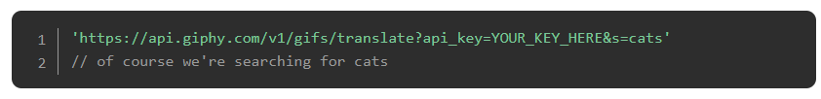
Fetching Data
Giphy has several methods for searching and finding gifs which you can read about in their documentation. Today we’re just going to use the ‘translate’ endpoint because it’s the simplest one for our purposes. You can find the appropriate URL in their documentation by scrolling down here. What it tells us is that the correct URL is api.giphy.com/v1/gifs/translate and that it requires 2 parameters, your api_key and a search term. If you put it all together correctly (with YOUR API key) you should get something like this:
Go ahead and try that URL (with YOUR API key) in a browser. If everything goes well you should get a relatively long string of data and no errors.

Slide 38
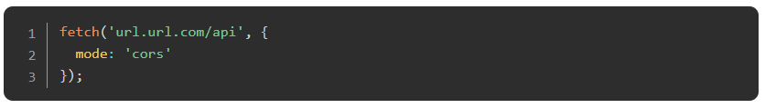
CORS
A side note before we start putting this into our code. For security reasons, by default, browsers restrict HTTP requests to outside sources (which is exactly what we’re trying to do here). There’s a very small amount of setup that we need to do to make fetching work. Learning about this is outside our scope right now, but if you want to learn a bit about it this Wikipedia article and this Javascript.info article are good starting points.
Whether or not you took the detour to learn all about Cross Origin Resource Sharing (CORS) the fix is simple. With fetch, you are able to easily supply a JavaScript object for options. It comes right after the URL as a second parameter to the fetch function:
Simply adding the {mode: 'cors'} after the URL, as shown above, will solve our problems for now. In the future, however, you may want to look further into the implications of this restriction.

Slide 39
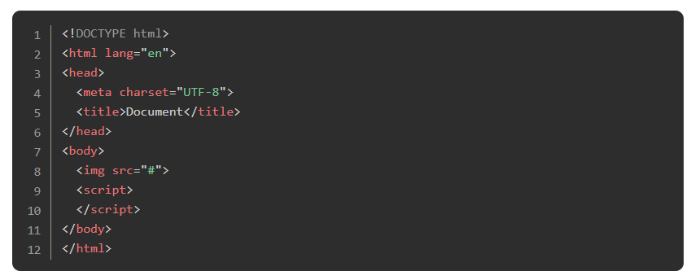
Let’s Do This
For now, we’re going to keep all of this in a single HTML file. So go ahead and create one with a single blank image tag and an empty script tag in the body.

Slide 40
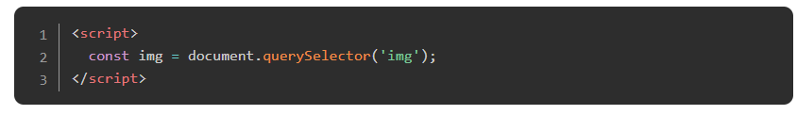
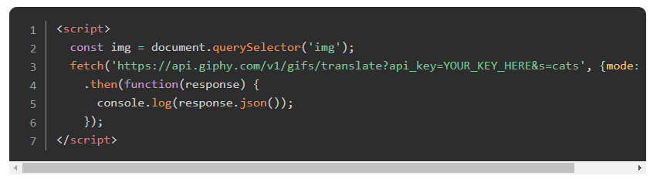
Let’s Do This
In the script tag, let’s start by selecting the image and assigning it to a variable so that we can change the URL once we’ve received it from the Giphy API.
Adding fetch with our URL from above is also relatively easy:

Slide 41
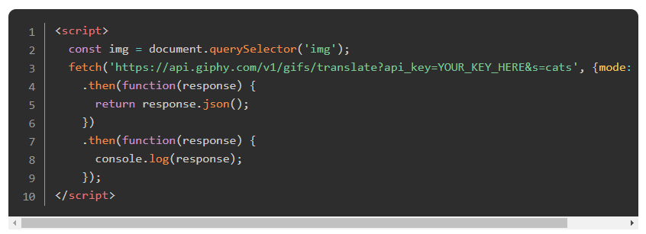
Let’s Do This
You should now be able to open the HTML file in your browser, and while you won’t see anything on the page, you should have something logged in the console. The trickiest part of this whole process is deciphering how to get to the data you desire from the server’s response. In this case, inspecting the browser’s console will reveal that what’s being returned is another Promise… to get the data we need another .then() function.

Slide 42
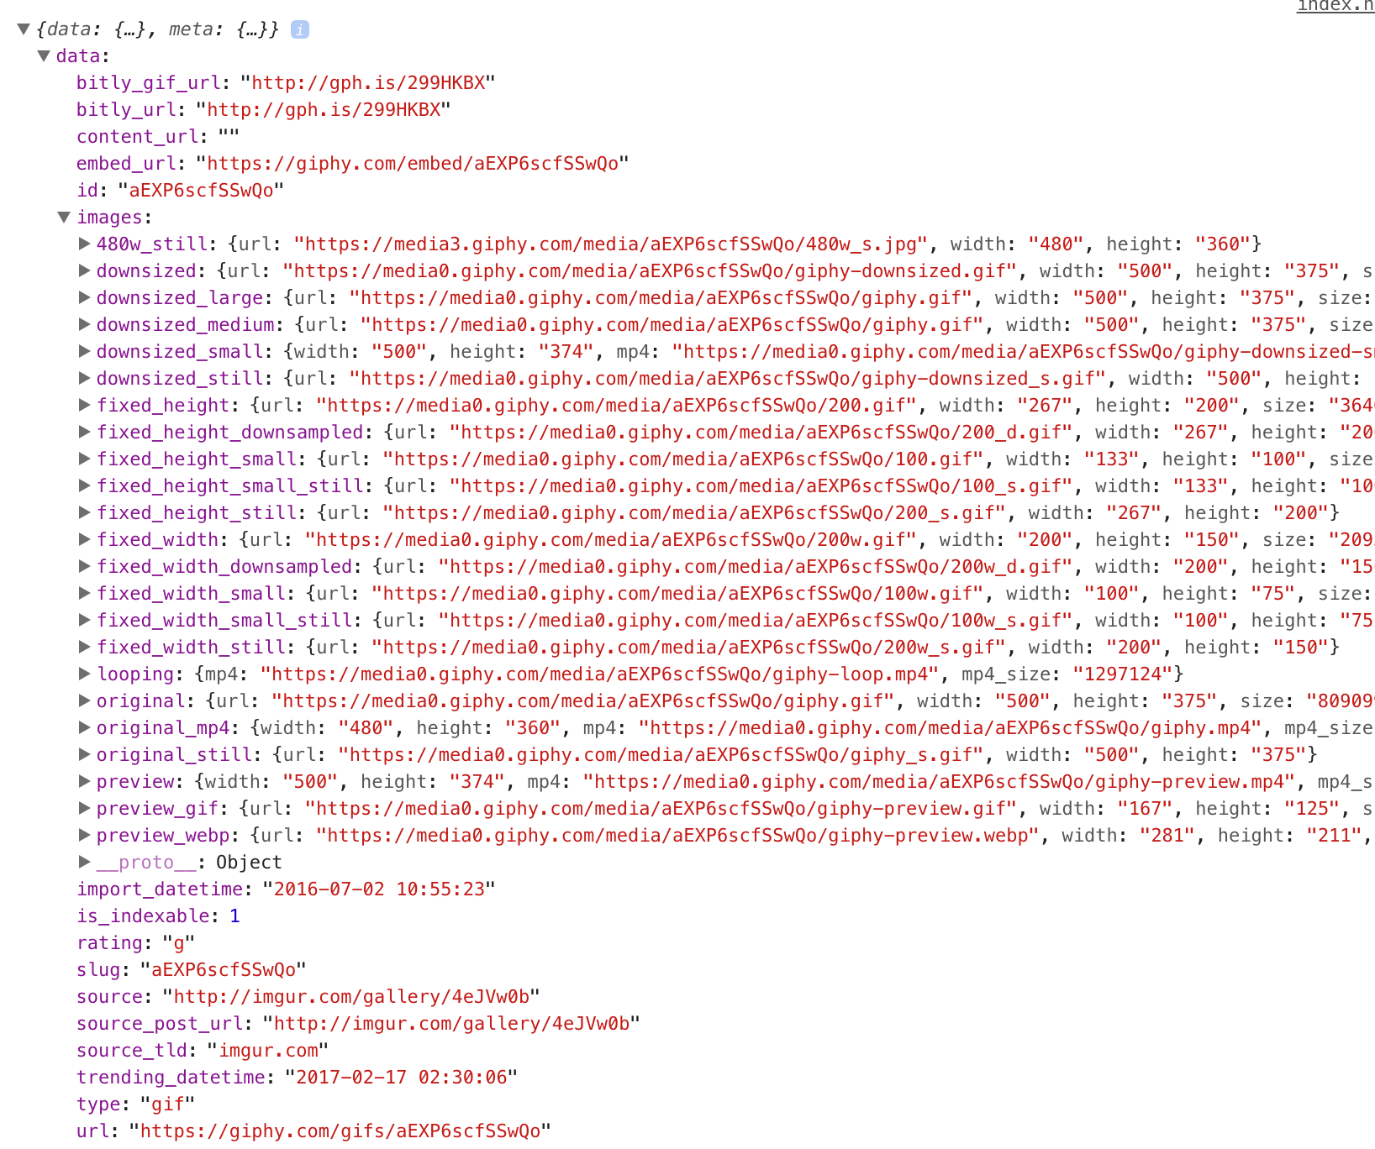
Let’s Do This
Now we have a JavaScript object and if you inspect it closely enough you’ll find that the data we need (an image URL) is nested rather deeply inside the object:

Slide 43
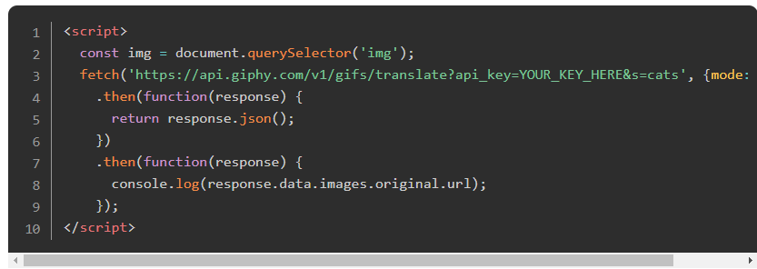
Let’s Do This
To get to the data we need to drill down through the layers of the object until we find what we want!

Slide 44
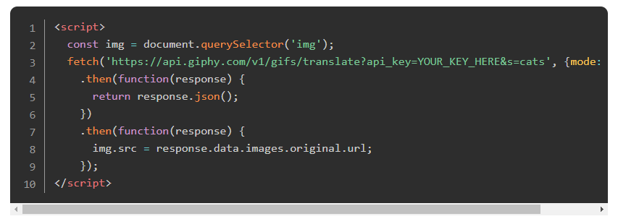
Let’s Do This
Running the file should now log the URL of the image. All that’s left to do is set the source of the image that’s on the page to the URL we’ve just accessed:

Slide 45
Let’s Do This
f all goes well, you should see a new image on the page every time you refresh!
If you’ve gotten lost along the way, check out this jsbin project. Besides the glorious styling, this is what your version should look like.
While we are pushing this API key to the frontend, this isn’t something you should do with any key that is not free, anything on the client is public knowledge. Handling keys that are unsafe to push to the frontend will be taught in later sections if you haven’t been exposed in the Ruby course.

Slide 46
Read
Read the fetch documentation here. It’s not all that complicated to use, but we’ve only really scratched the surface at this point.

Slide 47
Check this
Check out this list and this list of free, open APIs and let your imagination go wild.

Slide 48
Expand
Expand on our little project here by adding a button that fetches a new image without refreshing the page.

Slide 49
Add Buttons
Add a search box so users can search for specific gifs. You should also investigate adding a .catch() to the end of the promise chain in case Giphy doesn’t find any gifs with the searched keyword. Add a default image, or an error message if the search fails.

Slide 50
Knowledge Check

Slide 51
What is an API?
Notes:
🍐 This is a Pear Deck Text Slide
🍐 To edit the type of question, go back to the "Ask Students a Question" in the Pear Deck sidebar.

Slide 52
How do you fetch and extract data from an API?
Notes:
🍐 This is a Pear Deck Text Slide
🍐 To edit the type of question, go back to the "Ask Students a Question" in the Pear Deck sidebar.

Slide 53
Why might your API request be blocked by the browser, and how might you fix this?
Notes:
🍐 This is a Pear Deck Text Slide
🍐 To edit the type of question, go back to the "Ask Students a Question" in the Pear Deck sidebar.

Slide 54
ASYNC AND AWAIT

Slide 55
Introduction
Asynchronous code can become difficult to follow when it has a lot of things going on. async and await are two keywords that can help make asynchronous read more like synchronous code. This can help code look cleaner while keeping the benefits of asynchronous code.
For example, the two code blocks below do the exact same thing, they both get information from a server, process it, and return a promise.

Slide 56
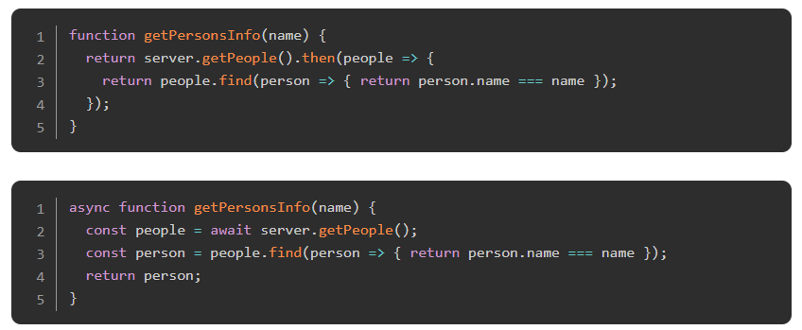
Introduction
Notes:
The second example looks much more like the kind of functions you are used to writing, however, did you notice the async keyword before the function declaration? How about the await keyword before server.getPeople()?

Slide 57
Learning Outcomes
Explain how you declare an async function
Explain what the async keyword does
Explain what the await keyword does
Explain what an async function returns
Explain what happens when an error is thrown inside an async function
Explain how you can handle errors inside an async function

Slide 58
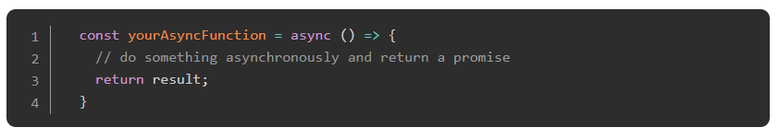
The async keyword
The async keyword is what lets the JavaScript engine know that you are declaring an asynchronous function, this is required to use await inside any function. When a function is declared with async, it automatically returns a promise, returning in an async function is the same as resolving a promise, likewise, throwing an error will reject the promise.
An important thing to understand is async functions are just syntactical sugar for promises.
The async keyword can also be used with any of the ways a function can be created, said differently: it is valid to use an async function anywhere you can use a normal function. Below you will see some examples that may not be intuitive, if you don’t understand them, come back and take a look when you are done with the assignments.

Slide 59
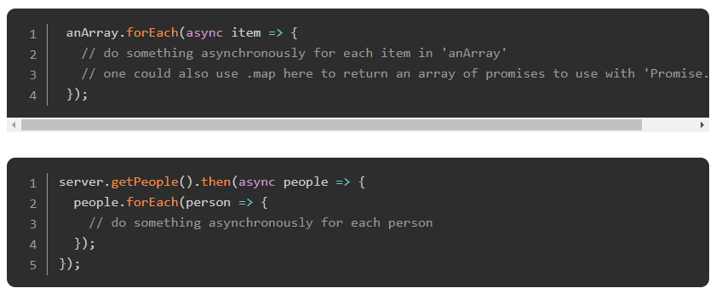
The async keyword

Slide 60
The await keyword
await is pretty simple: it tells JavaScript to wait for an asynchronous action to finish before continuing the function. It’s like a ‘pause until done’ keyword. The await keyword is used to get a value from a function where you would normally use .then(). Instead of calling .then() after the asynchronous function, you would simply assign a variable to the result using await, then you can use the result in your code as you would in your synchronous code.

Slide 61
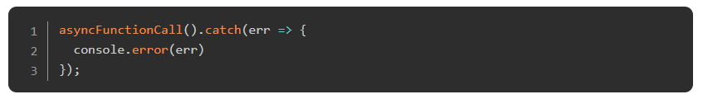
Error Handling
Handling errors in async functions is very easy. Promises have the .catch() method for handling rejected promises, and since async functions just return a promise, you can simply call the function, and append a .catch() method to the end.

Slide 62
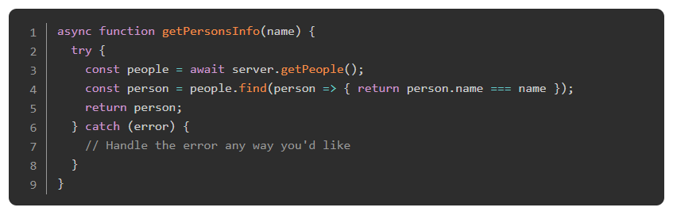
Error Handling
But there is another way: the mighty try/catch block! If you want to handle the error directly inside the async function, you can use try/catch just like you would inside synchronous code.
Doing this can look messy, but it is a very easy way to handle errors without appending .catch() after your function calls. How you handle the errors is up to you, and which method you use should be determined by how your code was written. You will get a feel for what needs to be done over time. The assignments will also help you understand how to handle your errors.

Slide 63
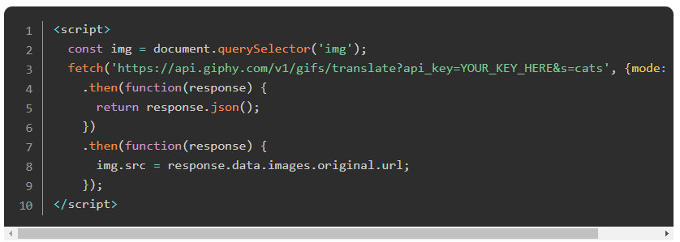
Practice
Remember the Giphy API practice project? (If not, you should go back and complete the API lesson) We are going to convert the promise based code into async/await compatible code. Here’s a refresher of the code we are starting with:

Slide 64
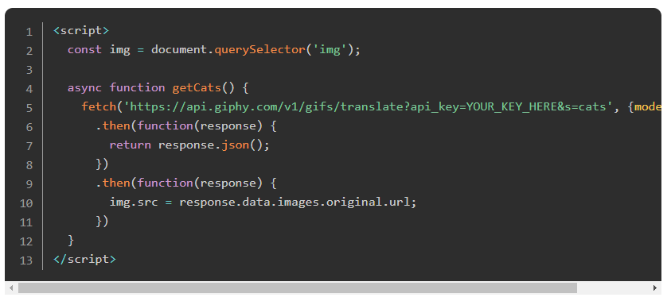
Practice
Since await does not work on the global scope, we will have to create an async function that wraps our API call to Giphy.

Slide 65
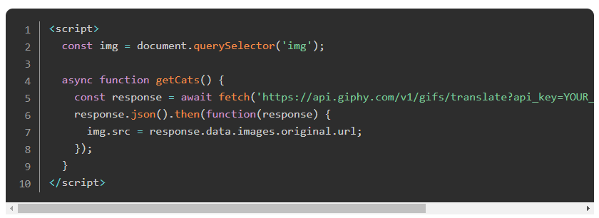
Practice
Now that we have a function that is asynchronous, we can then start refactoring from using promises to using await:

Slide 66
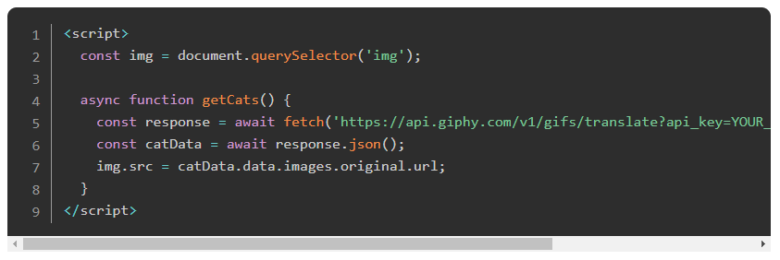
Practice
Since response is still the same object we have passed to the .then() block at the start, we still need to use the .json() method, which in turn returns a promise. Because .json() returns a promise, we can use await to assign the response to a variable.

Slide 67
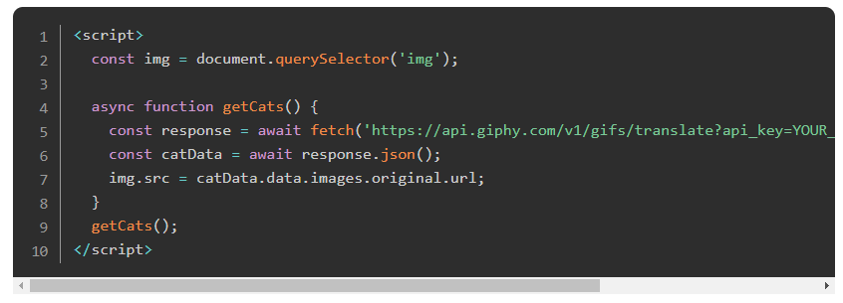
Practice
To use this function, we just simply need to call it with getCats() in our code.

Slide 68
Practice
This code will behave exactly like the code from the last lesson, it just looks a bit different after refactoring. async/await are very useful tools when it comes to cleaning up asynchronous JavaScript code. It is important to remember async/await are just promises written in a different way. Do the assignments below, and dive deeper into the understanding of async/await.

Slide 69
Read
Read this article for a solid introduction to async/await. this article also has some good examples of its use.

Slide 70
Another Read
Read this article for a more in-depth look at async/await, including how to handle errors.

Slide 71
Watch
Watch this video for a good overview on async/await and it’s purpose, along with a special trick.

Slide 72
Knowledge Check

Slide 73
How do you declare an async function?
Notes:
🍐 This is a Pear Deck Text Slide
🍐 To edit the type of question, go back to the "Ask Students a Question" in the Pear Deck sidebar.

Slide 74
What does the async keyword do?
Notes:
🍐 This is a Pear Deck Text Slide
🍐 To edit the type of question, go back to the "Ask Students a Question" in the Pear Deck sidebar.

Slide 75
What does the await keyword do?
Notes:
🍐 This is a Pear Deck Text Slide
🍐 To edit the type of question, go back to the "Ask Students a Question" in the Pear Deck sidebar.

Slide 76
What is returned from an async function?
Notes:
🍐 This is a Pear Deck Text Slide
🍐 To edit the type of question, go back to the "Ask Students a Question" in the Pear Deck sidebar.

Slide 77
Resources
This video is an example of how you can change callbacks, to promises, to async/await.
This video gives a comprehensive view of Promises, async, and await.

Slide 78
Challenge Time!

Slide 79
Challenge: Weather App
Use everything we’ve been discussing to create a weather forecast site using the weather API from the previous lesson. You should be able to search for a specific location and toggle displaying the data in Fahrenheit or Celsius.
You should change the look of the page based on the data, maybe by changing the color of the background or by adding images that describe the weather. (You could even use the Giphy API to find appropriate weather-related gifs and display them). Feel free to use promises or async/await in your code, though you should try to become comfortable with both.

